Slide 1
A level MFL 2018
Getting ready to teach

Slide 2
Objectives
To:
Explore the question papers and mark schemes (please refer to the Specification and Sample assessment materials https://qualifications.pearson.com/en/qualifications/edexcel-a-levels/modern-languages-2016.html)
Look at teaching and learning strategies for integrating newer elements of the course
Find out more about the support available to guide you through these changes

Slide 3
Content
A level reforms and requirements for the new A level
Overview of new specification content
Paper 1 Assessment content
Paper 2 Assessment content
Paper 3 Assessment content
Support and resources

Slide 4
Languages for All
Content that engages, inspires and motivates your students
Manageable content and clear, structured assessment
Assessments that enable all students to reach their potential
Rich choice of popular and accessible literary texts and films, covering contemporary and classical titles from a range of directors and authors
Straightforward and clear mark schemes
Specification that builds transferable skills for progression to Language degrees or other degrees

Slide 5
AS & A level reforms
This qualification is offered at A level only.
All new A levels are fully linear. This means that all three papers must be taken in the same examination session at the end of the course.
The new A level is for first examination in 2020.

Slide 6
Key changes
A listening assessment has been added.
‘Topics and texts’ are now ‘Texts and Films’.
A synoptic task assessing mixed skills has been added (listening, reading and writing).
Renewed focus on culture with a specific assessment objective (AO4) that assesses knowledge and understanding of the TL culture via a research project.
All teaching and assessment will be centred around four themes; there is a research subject attached to each theme.

Slide 7
Assessment Objectives
 |  | Weighting
AO1 | Understand and respond in writing to spoken language drawn from a variety of sources | 20%
AO2 | Understand and respond in writing to written language drawn from a variety of sources | 30%
AO3 | Manipulate the language accurately, in written forms, using a range of lexis and structure. | 30%
AO4 | Show knowledge and understanding of, and respond critically and analytically to, different aspects of the culture and society of countries where the language is spoken. | 20%

Slide 8
Breakdown of assessment objectives
 | Assessment Objectives
 | AO1 % | AO2 % | AO3 % | AO4 % | Total for all Assessment Objectives
Paper 1:Translation into English, reading comprehension and writing (research question) |  | 25 | 5 | 10 | 40%
Paper 2:Translation into the target language and written response to works |  |  | 20 | 10 | 30%
Paper 3: Listening, reading and writing | 20 | 5 | 5 |  | 30%
Total for GCE A level | 20 | 30 | 30 | 20 | 100%

Slide 9
Paper 1: Translation into English, reading comprehension and writing (research question)
Section | Assessment 2 hours 30 minutes 40%
Section A: Translation into English (20 marks) | An unseen passage to be translated from the target language into English.
Section B: Reading (20 marks) | A reading assessment based on a variety of text types and genres. Students must respond to a series of comprehension questions.
Section C: Writing (research question) (40 marks) | A reading and writing question based on the student’s chosen research subject. Students read an unseen text and then answer a question. Students must use information and ideas both from the text and their research findings.

Slide 10
Paper 2: Translation into the target language and written response to works
Section | Assessment 2 hours 40 minutes 30%
Section A: Translation into target language (20 marks) | An unseen passage to be translated from English into the target language.
Section B: Written response to works (literary texts) (45 marks) | An extended response on either one or two of the prescribed literary texts. Students select one question from a choice of two on each work. If a student answers questions on two literary texts, they do not complete Section C (the film section).
Section C: Written response to works (films) (45 marks) | Students who answer only one question from a literary text in Section B must write an extended response on one of the films in Section C. Students select one question from a choice of two.

Slide 11
Paper 3: Listening, reading and writing
Section | Assessment 2 hours 15 minutes 30%
Section A: Listening comprehension (30 marks) | A listening assessment based on a recording that features male and female speakers of the target language. Students respond to comprehension questions.
Section B: Listening, reading and writing questions (30 marks) | Students summarise a listening source and a text that are based on the same sub-theme. Students evaluate the points of view in both sources, stating which views they agree with and why.

Slide 12
A more detailed look at each paper

Slide 13
Paper 1
Translation into English, reading comprehension and writing (research question)

Slide 14
Section A Translation into English
A short passage to be translated from the target language into English.
Passage will be based on one of the themes.
Points based mark scheme.
Recommended time 20 mins.
20 marks.

Slide 15
Section B Reading Comprehension
4 different passages to read.
One is a literary text but this will not be from one of the set texts (this builds on the GCSE reading comprehension).
Different types of question, e.g multiple choice, short, open-response.
Recommended time 45 minutes.
20 marks.
Points based mark scheme.

Slide 16
Section C: The research topic
Students have a choice of 4 research topics. There is one research topic linked to each Theme (see specification)
Students choose one research subject and research it independently
It is important that this is independent research. Guidance on what help teachers can / cannot offer is in the specification.
Students must use at least two authentic sources.
The focus is on understanding an aspect of the target language culture.

Slide 17
Teachers can
Give guidance on developing research skills.
Give guidance on the content of the research subjects.
Comment on the availability of resources and time constraints.
Advise and direct students to the Assessment Objectives.

Slide 18
Teachers must
Explain what independence means.
Confirm that students’ research meets all of the aspects of the research subject.
Ensure that students do not intend to use any of the literary works or films they have studied for Paper 2.
Monitor the research subjects and make sure that students are not working together.

Slide 19
Teachers must not
Teach the content of the research subjects.
Provide sources.

Slide 20
Section C: The research topic
In the exam:
Students choose ONE question.
Recommended time 1 hour 25 minutes.
Students address the statement printed beneath the unseen written text which is linked to the question and the research subject.
Students must use information from the unseen text which is part of the question.
Students must bring in extra information from their own research.

Slide 21
Marking of research question
There are three levels-based mark grids to be applied to this question.
These are:
knowledge and understanding of society and culture (via research) (20 marks)
understand and respond to written language in writing (relates to the unseen text) (10 marks)
accuracy and range of language (relates to the whole written response) (10 marks)

Slide 22
Preparing students for the research question
Have a detailed look at the mark scheme.
Note that students gain most marks for their research rather than for their referencing of the unseen text so this must be the focus of the response.
Students must link their research to the unseen text. However, the point of the task is not to analyse the unseen text but to analyse the research findings.

Slide 23
Paper 2 Translation into target language and written response to works

Slide 24
Section A Translation into target language
Students must translate an unseen text from English into target language.
The content of the translation will be based on one of the themes.
30 minutes (recommended timing)
20 marks
Points based mark scheme in 20 sections

Slide 25
Sections B and C:Written response to works (literary texts/films)
Students must answer two questions
They must either answer one question on a literary text (from Section B) and one question on a film (from Section C) OR two questions on a literary text. They must NOT answer two questions on a film.
Each question offers a choice of essay title (a) or (b)

Slide 26
Filming techniques
If students are studying a film, they will need to think about filming techniques such as:
Camera work
Sound
Position of characters
Lighting
Music
Colours
Movement

Slide 27
Filming techniques
Aspects that questions may include:
Why did the director use that technique?
What is the impact on the viewer?
Are the techniques effective? Why or why not?

Slide 28
Texts and Films Questions Marking
These essays are marked according to three mark grids:
Critical analysis and response (20 marks)
Range of grammatical structures and vocabulary (15 marks)
Accuracy of language (10 marks).

Slide 29
What is required in sections B and C
It is important to note the importance of critical analysis.
Essays must be critical and analytical, not purely descriptive. (Students will lose marks if they simply re-tell the story).
Supporting evidence must be given from the text or film.

Slide 30
Paper 3 Listening, reading and writing

Slide 31
Section A Listening Comprehension
4 questions with a mixture of question types e.g multiple choice, short answer open response.
Includes inference questions.
Students will have individual control of the recording.
Recommended time 45 minutes.
30 marks.
Marked according to a points-based mark scheme.

Slide 32
Section A (Listening Comprehension)
Where an open-response, written answer is required, this must be in the target language.
Note form is acceptable, whole sentences are not required.
Students should not transcribe whole chunks.
Question 3 (b) (i) requires a summary.
Recordings of the SAMs can be found on the website.

Slide 33
Section B Listening, reading and writing
Students listen to a recording and read a written text.
Students must summarise points of view in both sources.
Students answer a question in writing which requires them to evaluate the viewpoints in both sources.
Students draw conclusions.
Recommended time 1 hour 30 minutes.
30 marks.

Slide 34
Section B Listening, reading and writing
Question 5 (a) – students note down 4 key points about opinions / viewpoints from a spoken passage.
Question 5 (b) – students note down 4 key points about opinions / viewpoints from a written passage.
The theme and content of 5 (a) and 5 (b) will be the same.

Slide 35
Section B Listening, reading and writing
In section 5 (c), students must write in the target language.
They must evaluate both points of view.
They must state their own conclusion.
The writing is assessed on three criteria via levels-based mark grids:
understand and respond to spoken language (6 marks)
understand and respond to written language (6 marks)
accuracy and range of language (10 marks)

Slide 36
Teaching and learning support
Support around literary works and films
Support around independent research project
https://qualifications.pearson.com/en/qualifications/edexcel-a-levels/modern-languages-2016.html

Slide 37
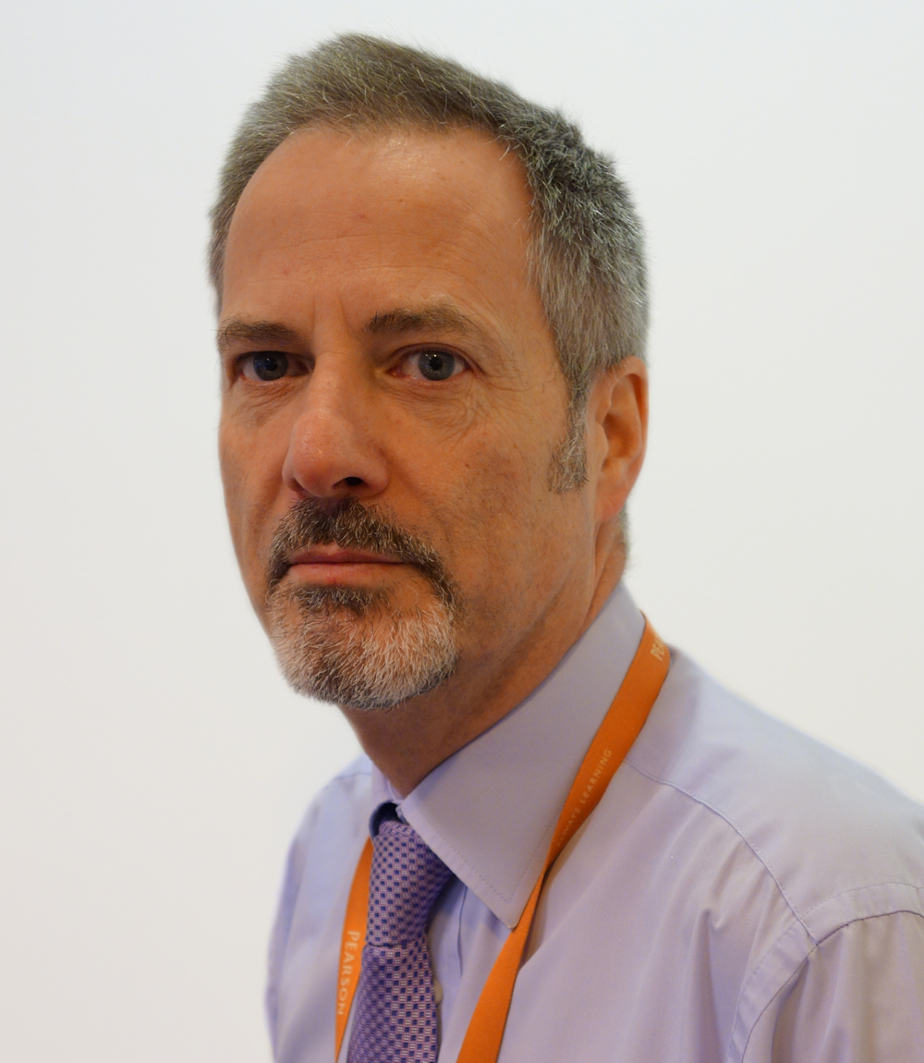
Contact details
Alistair Drewery, Subject Advisor
Phone:
UK: 0844 576 0035
Intl: +44 (0) 207 010 2187
Email: TeachingLanguages@pearson.com
Twitter: @PearsonMFLquals
Sign up today to receive Subject Advisor emails

Slide 38
Next steps
Sign up to our updates: email - TeachingLanguages@pearson.com
Visit the website to download further copies of the draft specification and support materials:
https://qualifications.pearson.com/en/qualifications/edexcel-a-levels/modern-languages-2016.html

Slide 39
Thank you!

